Slide 1
Cage Choke Technology Overview

Slide 2
Choke Valve Designs/History
Needle and Seat
1925

Slide 3
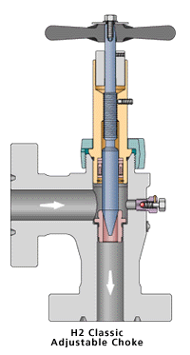
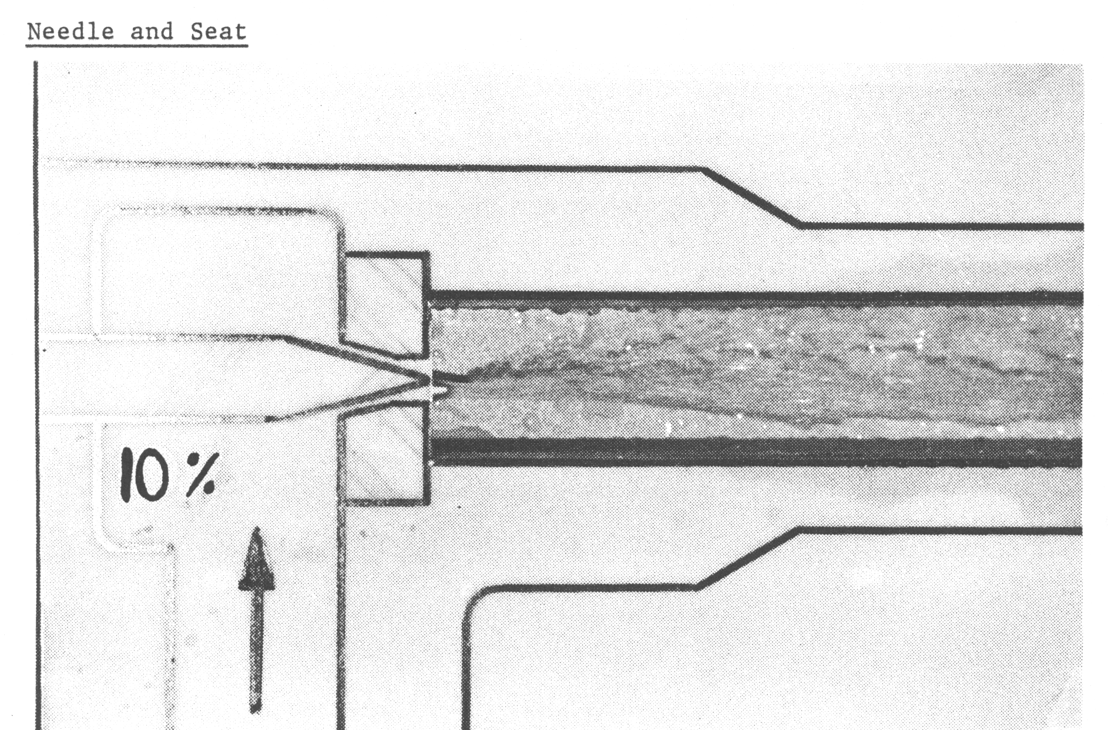
Needle and Seat

Slide 4
Choke Valve Designs/History
MOV or Disk Chokes 1962

Slide 5
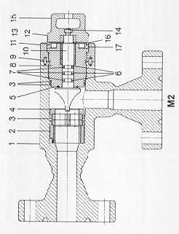
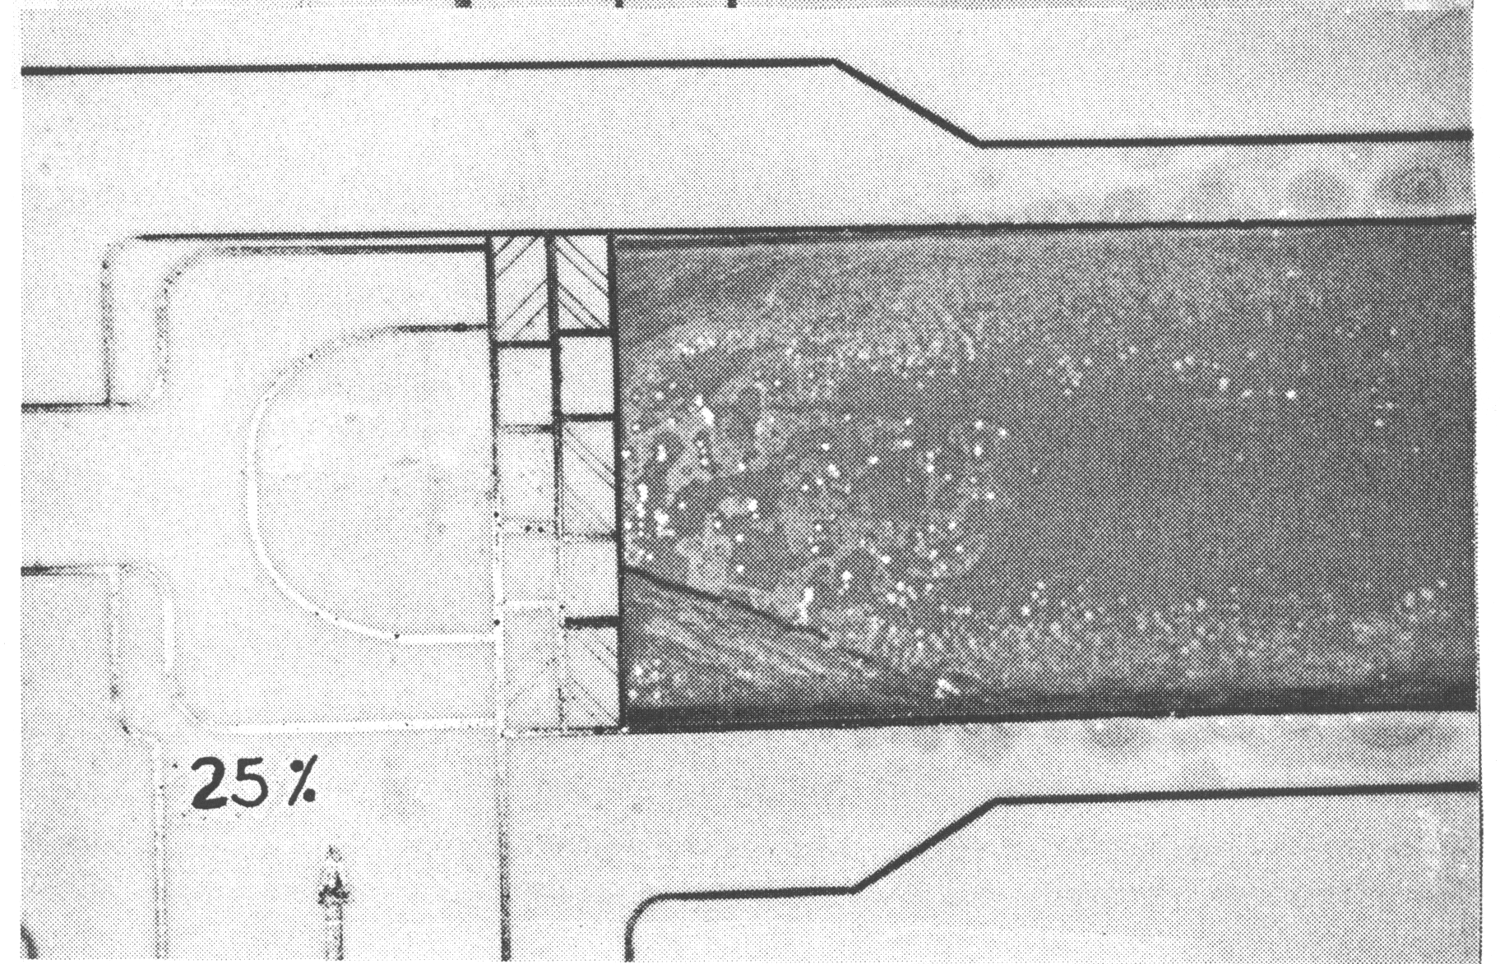

M.O.V. Choke Design or Disk Design

Slide 6
Choke Valve Designs/History
Cage with Internal Plug 1979

Slide 7
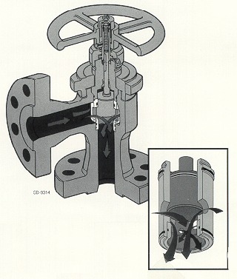
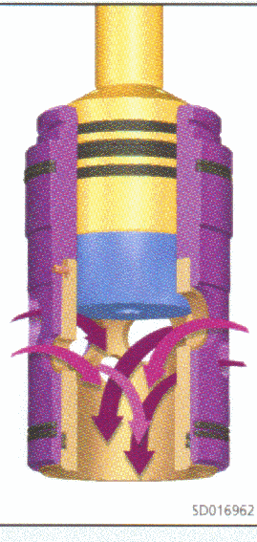
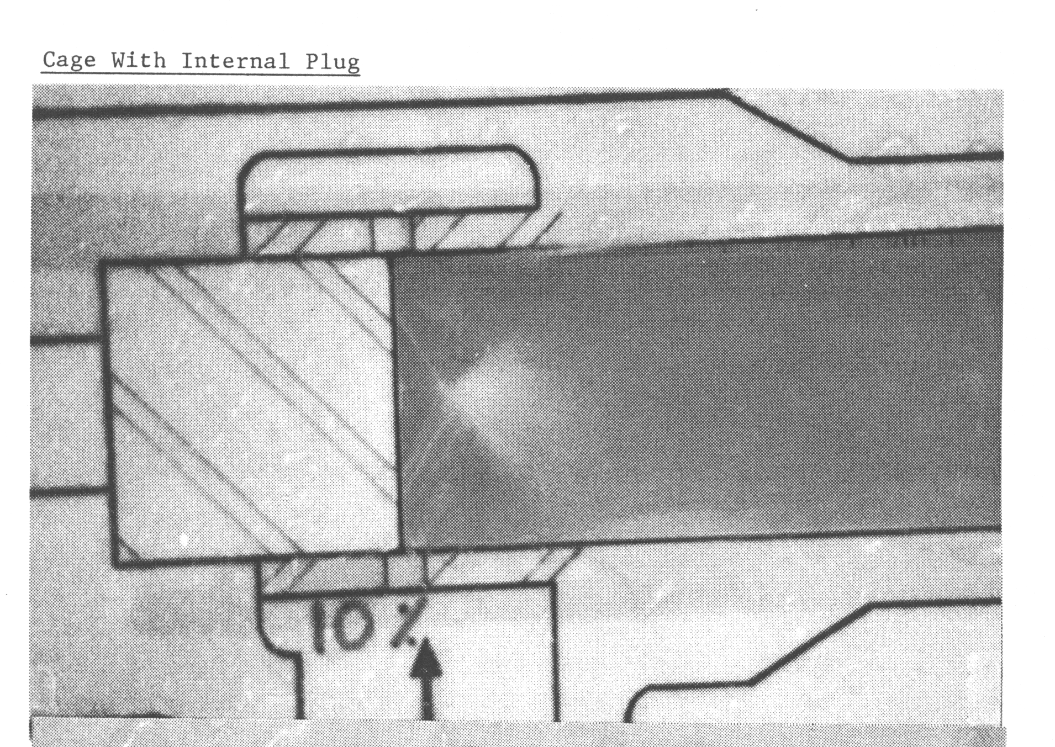
Cage-Internal Plug Competitors Design
Semi-Balanced Plug

Slide 8
Choke Valve Designs/History
Cage with External Sleeve 1980

Slide 9
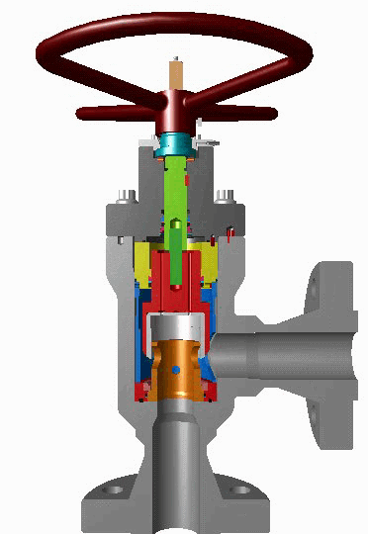
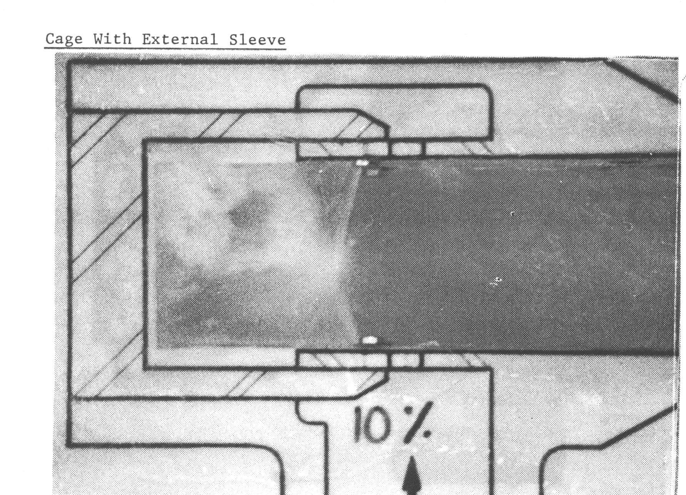
Cage-External Sleeve
Animation

Slide 10
Velocity Management combined with Trim Material Matrix leads to Erosion Control

Slide 11
Erosion Control through Velocity Management
D
Trim exist velocity
C
Velocity through Trim Orifice
B
Velocity in Valve Body
A
Velocity entering Valve Body

Slide 12
Erosion Control through Velocity Management
B
Body Velocity
Velocity must be acceptable for alloy or stainless steel material.
Typical hardness Rc 22
C
Velocity
Tungsten Carbide Trim allows high or acceptable velocity.
Typical hardness RA 94
Fluid energy absorbed
INLET
D
Trim Exit Velocity
Velocity must be acceptable for alloy or stainless steel material.
Typical hardness Rc 22
A
Inlet Velocity
Inlet velocity must be acceptable for alloy or stainless steel material.
Typical hardness Rc 22
OUTLET

Slide 13
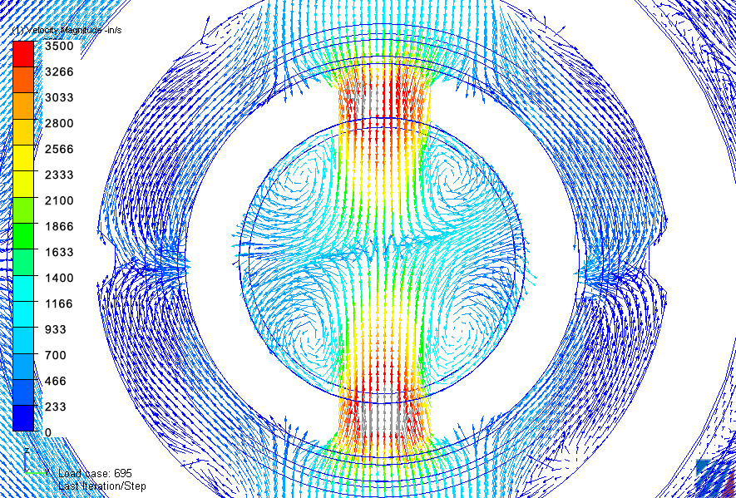

Computational Fluid Dynamics
Top View
Flow through large ports
50% open
(Choke 67.5% open)
FL value
Greater then 90

Slide 14
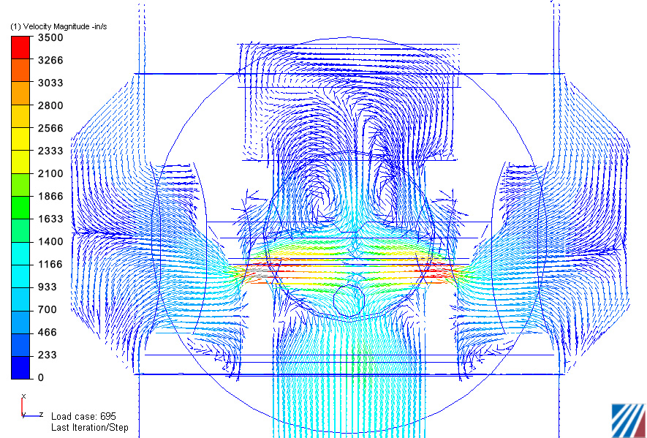
CFD evidence of High FL
Side View
Flow through large ports 50% open
Actual Choke opening 67.5%
>90 FL Evident with reduced Velocity in the outlet

Slide 15
Plug & Cage Verses External Sleeve Benchmarking R & D

Slide 16
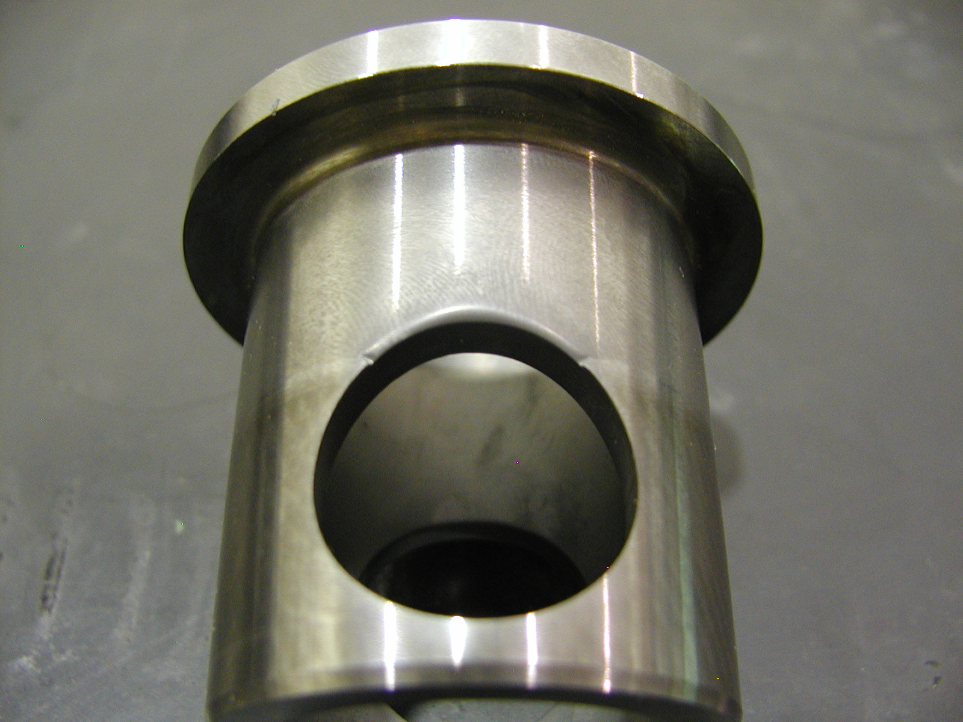
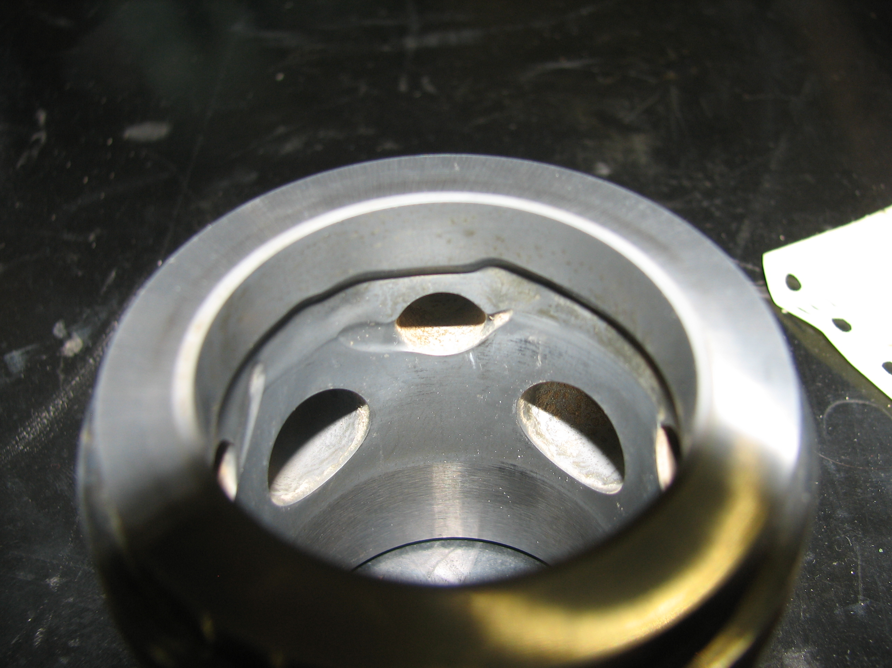
Cage
EXTERNAL SLEEVE DESIGN
INTERNAL PLUG DESIGN
Outlet
MINOR MATERIAL LOSS
TOTAL LOSS AFTER 8 HOURS – 3.92g
SIGNIFICANT MATERIAL LOSS
TOTAL LOSS AFTER 8 HOURS – 11.65g
3 times

Slide 17
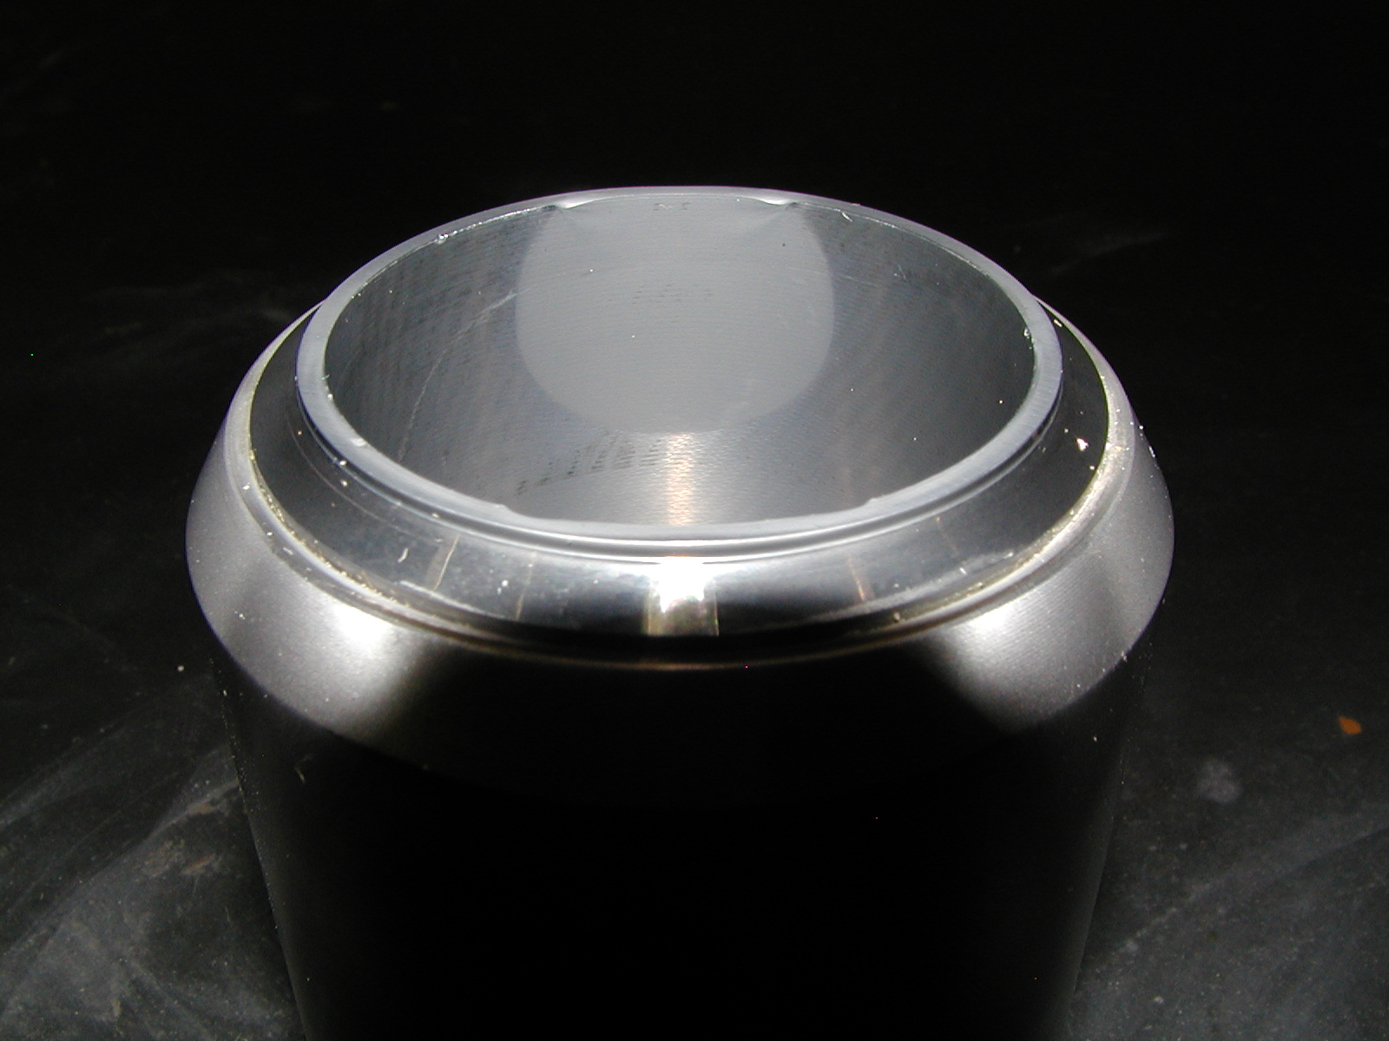
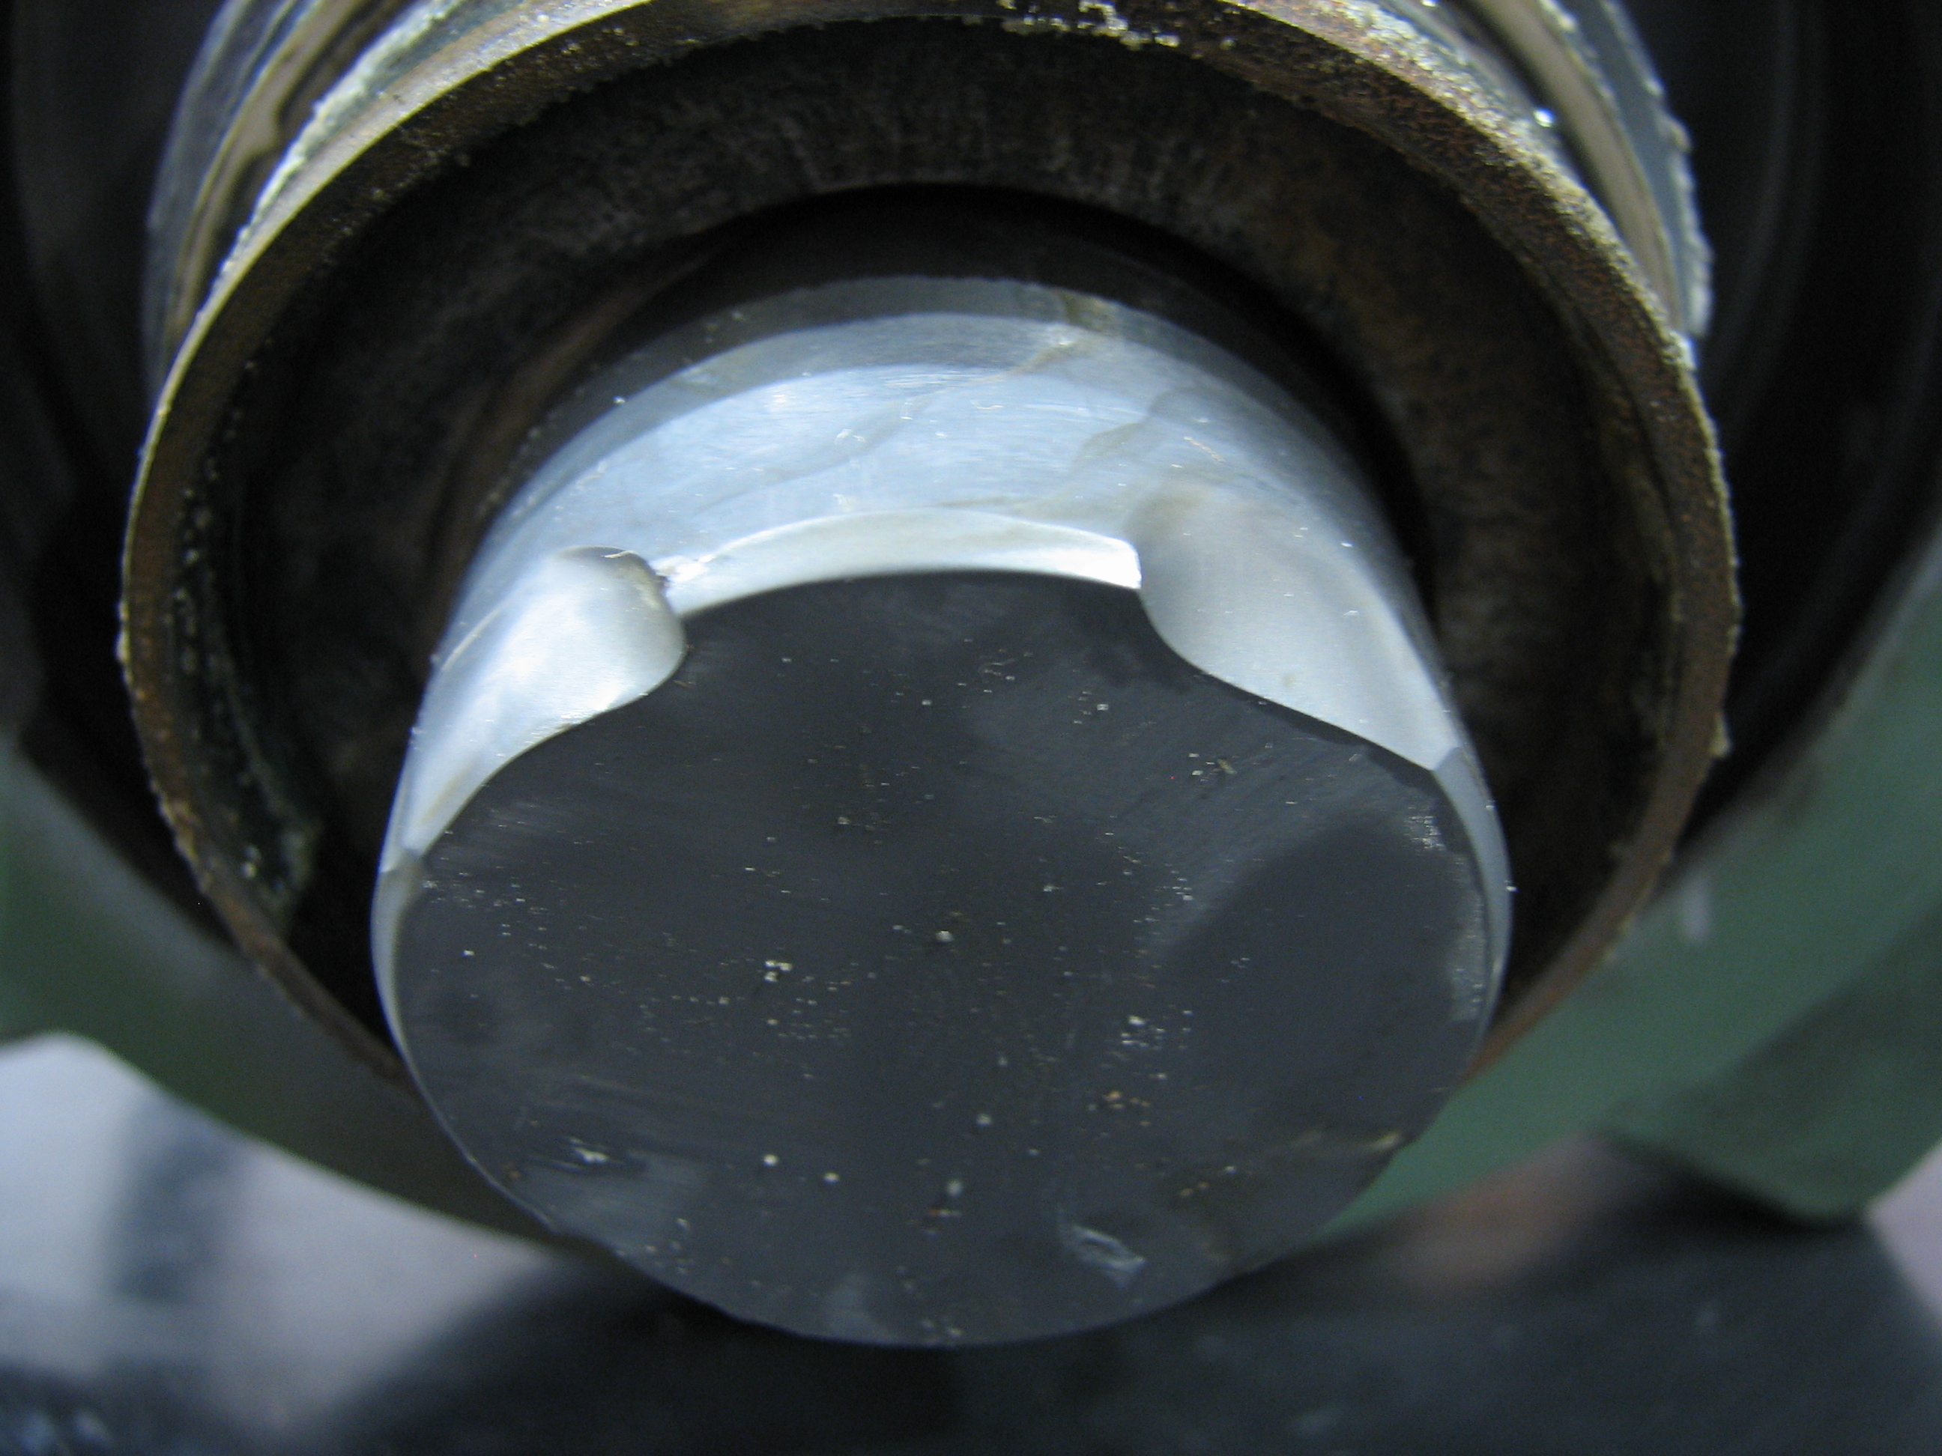
External Collar / Internal Plug
EXTERNAL SLEEVE DESIGN
INTERNAL PLUG DESIGN
MINOR MATERIAL LOSS
TOTAL LOSS AFTER 8 HOURS – 0.28g
SIGNIFICANT MATERIAL LOSS
TOTAL LOSS AFTER 8 HOURS – 6.02g
21.5 times

Slide 18
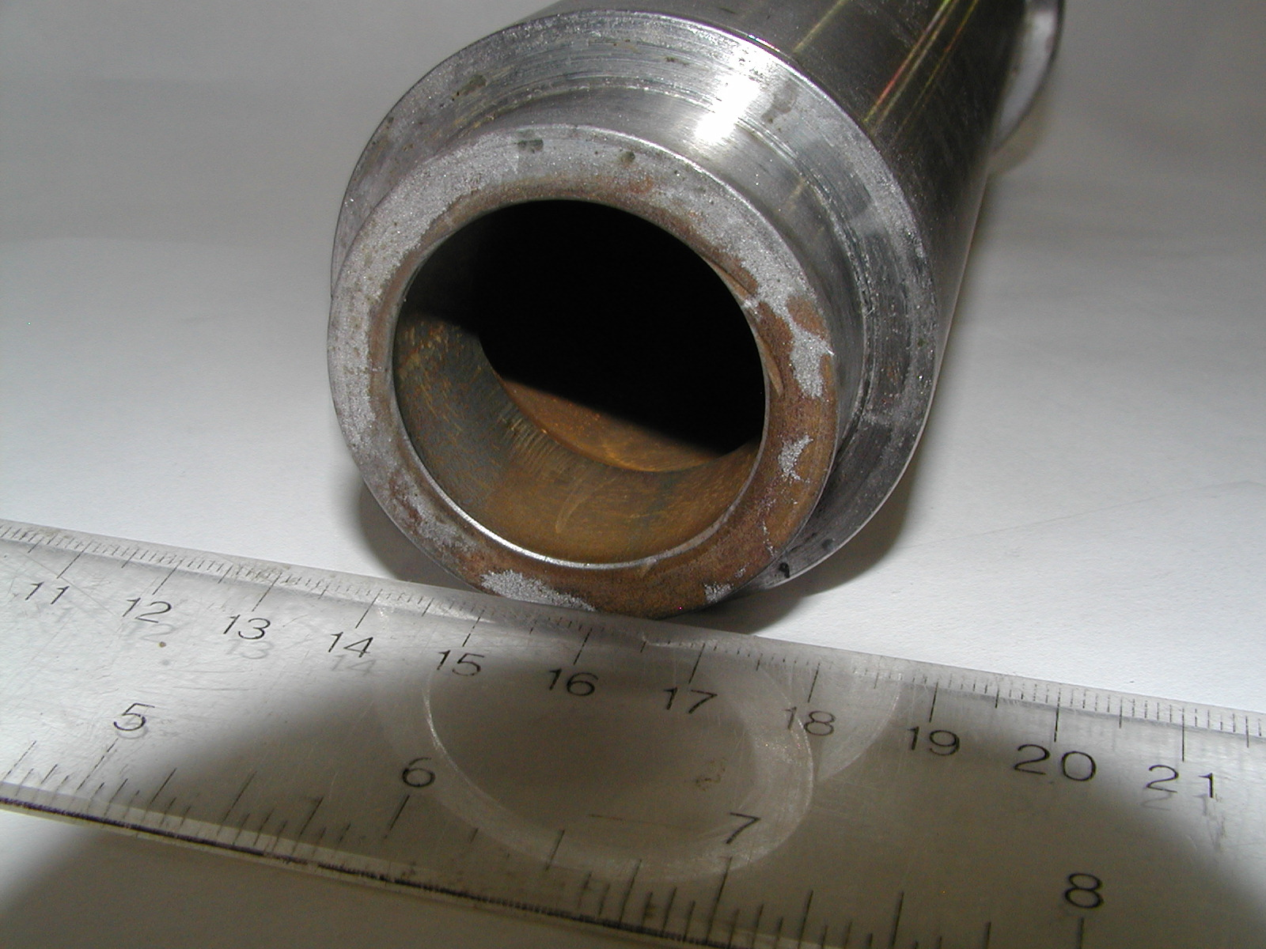
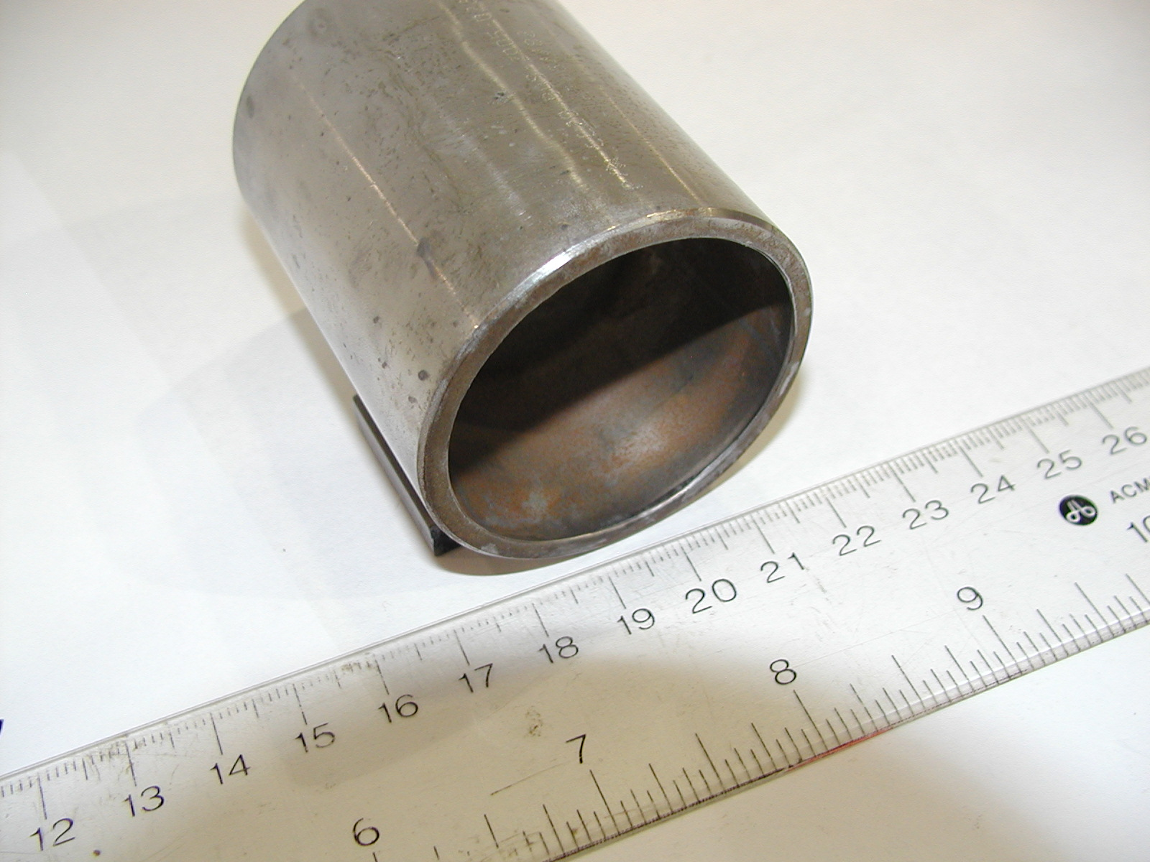
Outlet Sleeve
EXTERNAL SLEEVE DESIGN
INTERNAL PLUG DESIGN
Outlet
1.25 diameter
1.75 diameter
Outlet
MINOR MATERIAL LOSS
EROSION DEPTH – 0.034 inches
TOTAL LOSS AFTER 8 HOURS – 15.83g
SIGNIFICANT MATERIAL LOSS
EROSION DEPTH – 0.115 inches
TOTAL LOSS AFTER 8 HOURS – 76.64g
4.8 times mass loss and 3.38 times depth

Slide 19
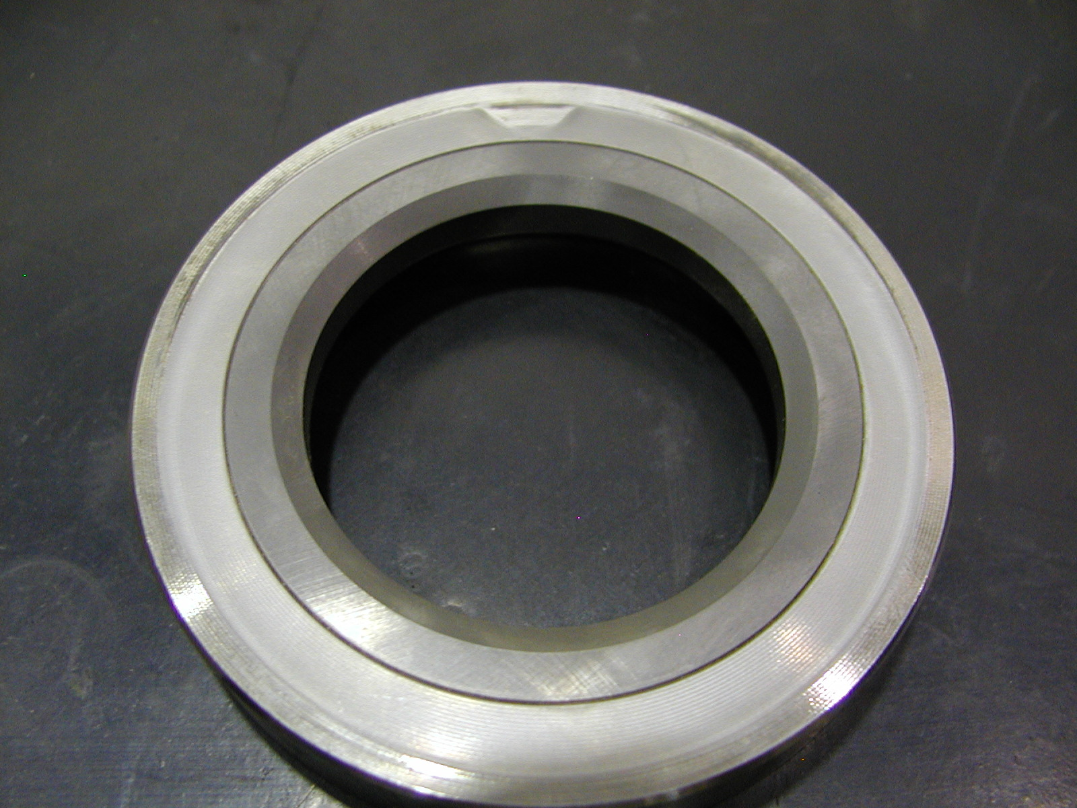
Seat
EXTERNAL SLEEVE DESIGN
INTERNAL PLUG DESIGN
Seat face
Seat face
NO EROSION; CLASS V SHUTOFF
MAINTAINED AFTER 8 HOURS
SIGNIFICANT MATERIAL LOSS
TO SEAT
SHUTOFF LOST AFTER 1/2 HOUR

Slide 20
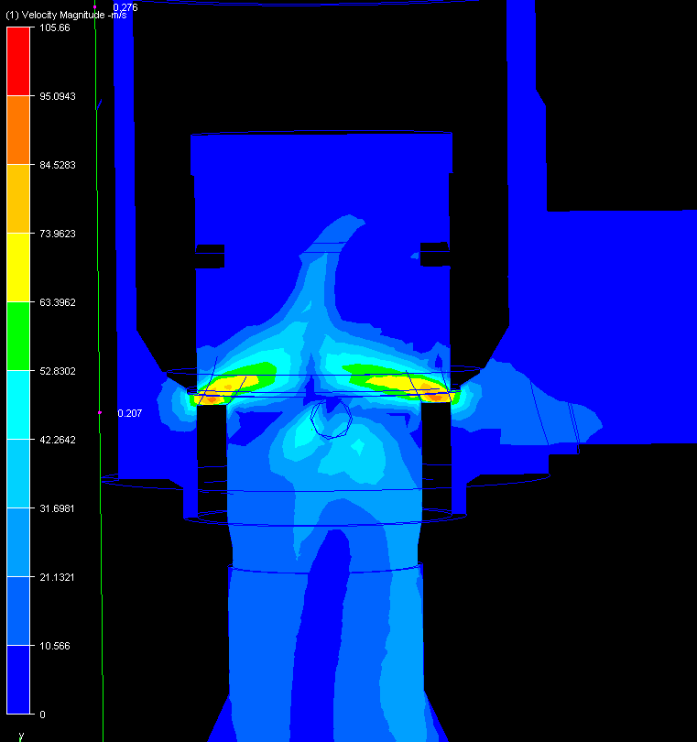
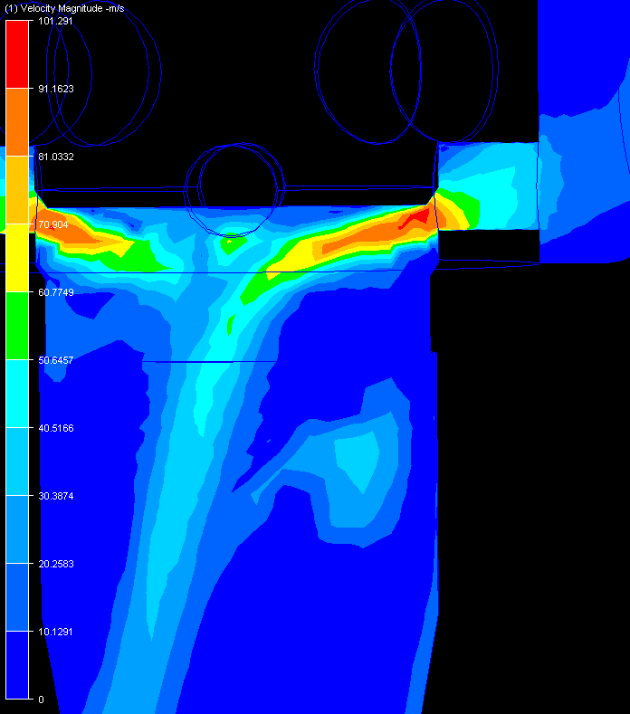
CFD Analysis of Fluid Management
EXTERNAL SLEEVE
Cage port
Body outlet starts
INTERNAL PLUG
Cage port
Body outlet starts

Slide 21
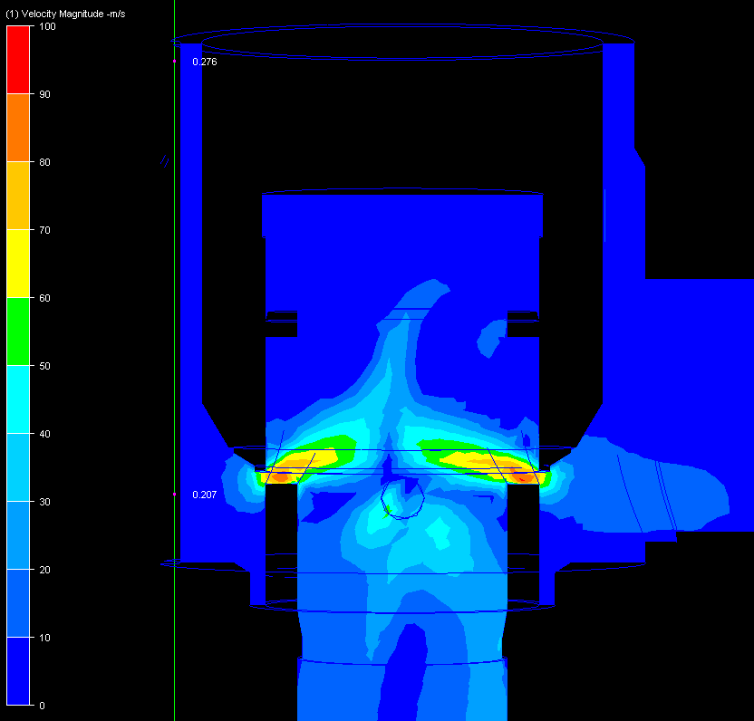
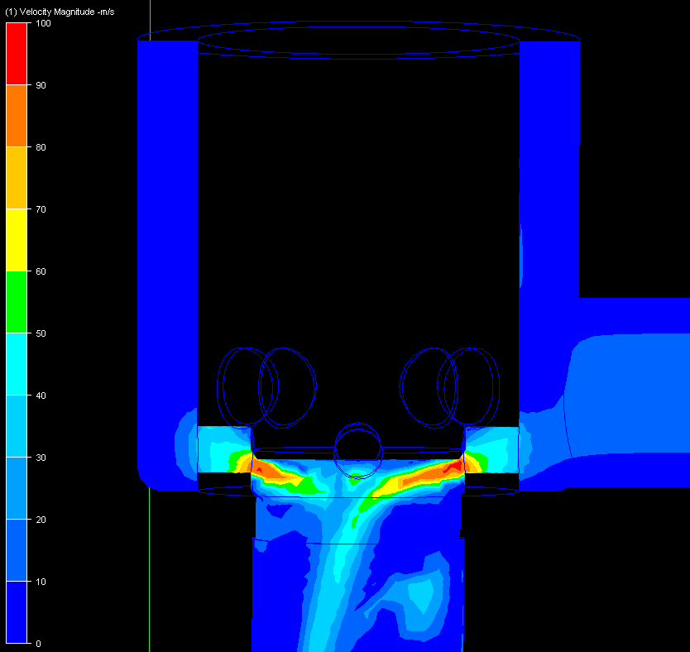
CFD Analysis of Fluid Management

Slide 22
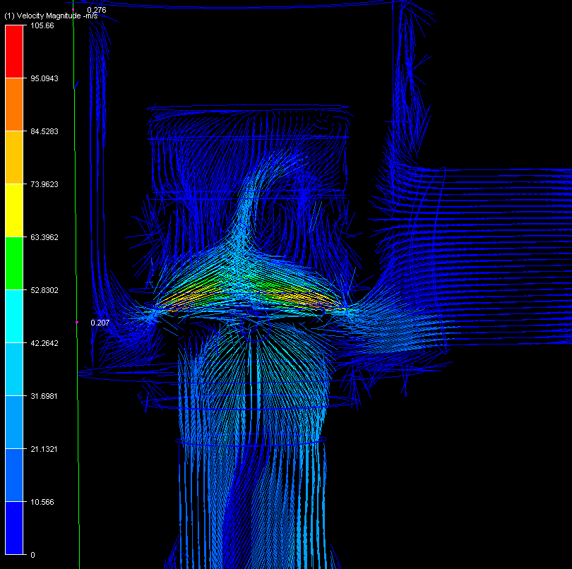
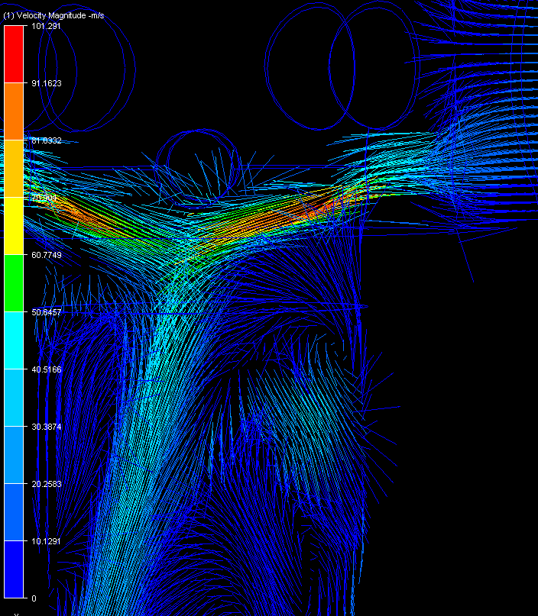
CFD Analysis of Fluid Management
EXTERNAL SLEEVE
Body outlet starts
INTERNAL PLUG
Body outlet starts

